Slide 1
Angular Services
Christopher Martinez

Slide 2
Prerequisites
Install NodeJS
Command Prompt/terminal
Check node version using the node –v command
To check if you have npm run the npm –v to see if it is installed
npm install -g @angular/cli to install Angular CLI
NOTE: npm install installs all necessary dependencies
Type ng version to check the version of Angular CLI
If problems still occur, use npm install then npm install –g npm to fix any vulnerabilities
ng serve -o
We will use VS Code and Gitbash for this workshop

Slide 3
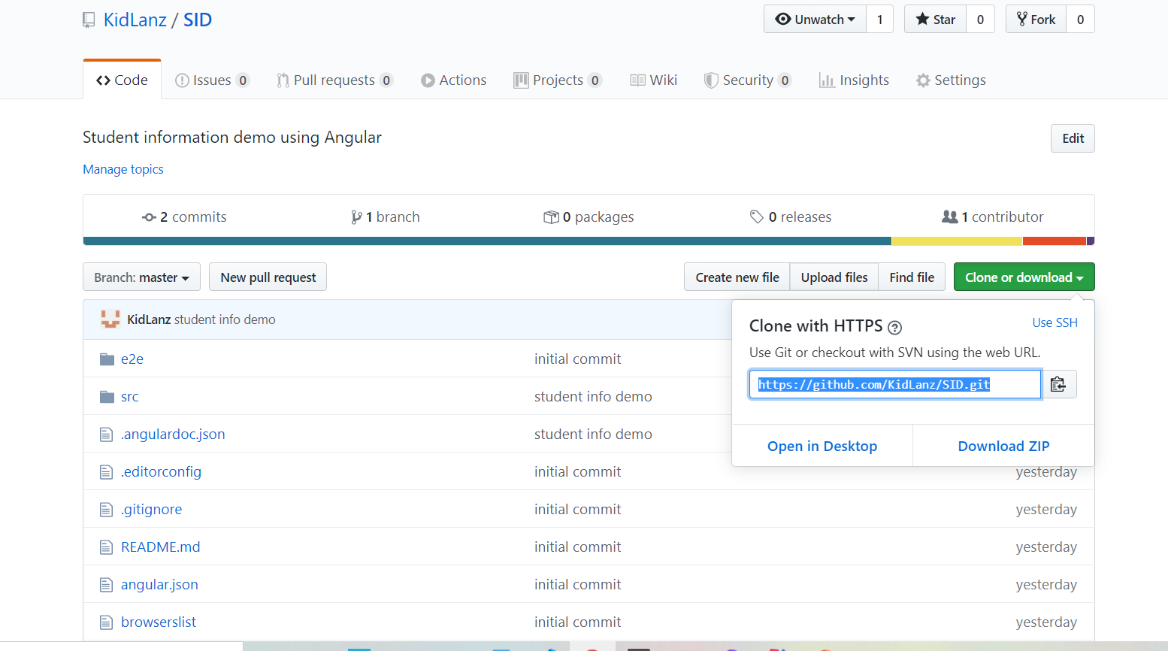
GitHub
git clone https://github.com/KidLanz/SID.git
Command Prompt/Terminal:
cd Desktop/demo/SID
code .
NOTE: this is to open VScode in the command prompt
npm install
NOTE: This is to install it into the folder
ng serve –o
This is to open the html to browser

Slide 4
Why is the Code Wrong?
D.R.Y. – Don’t Repeat Yourself
Making copies of the code
Revisiting multiple classes for the same code
Modeling – grabbing and manipulation of data
This is where we interact with the database/communicates with controller

Slide 5
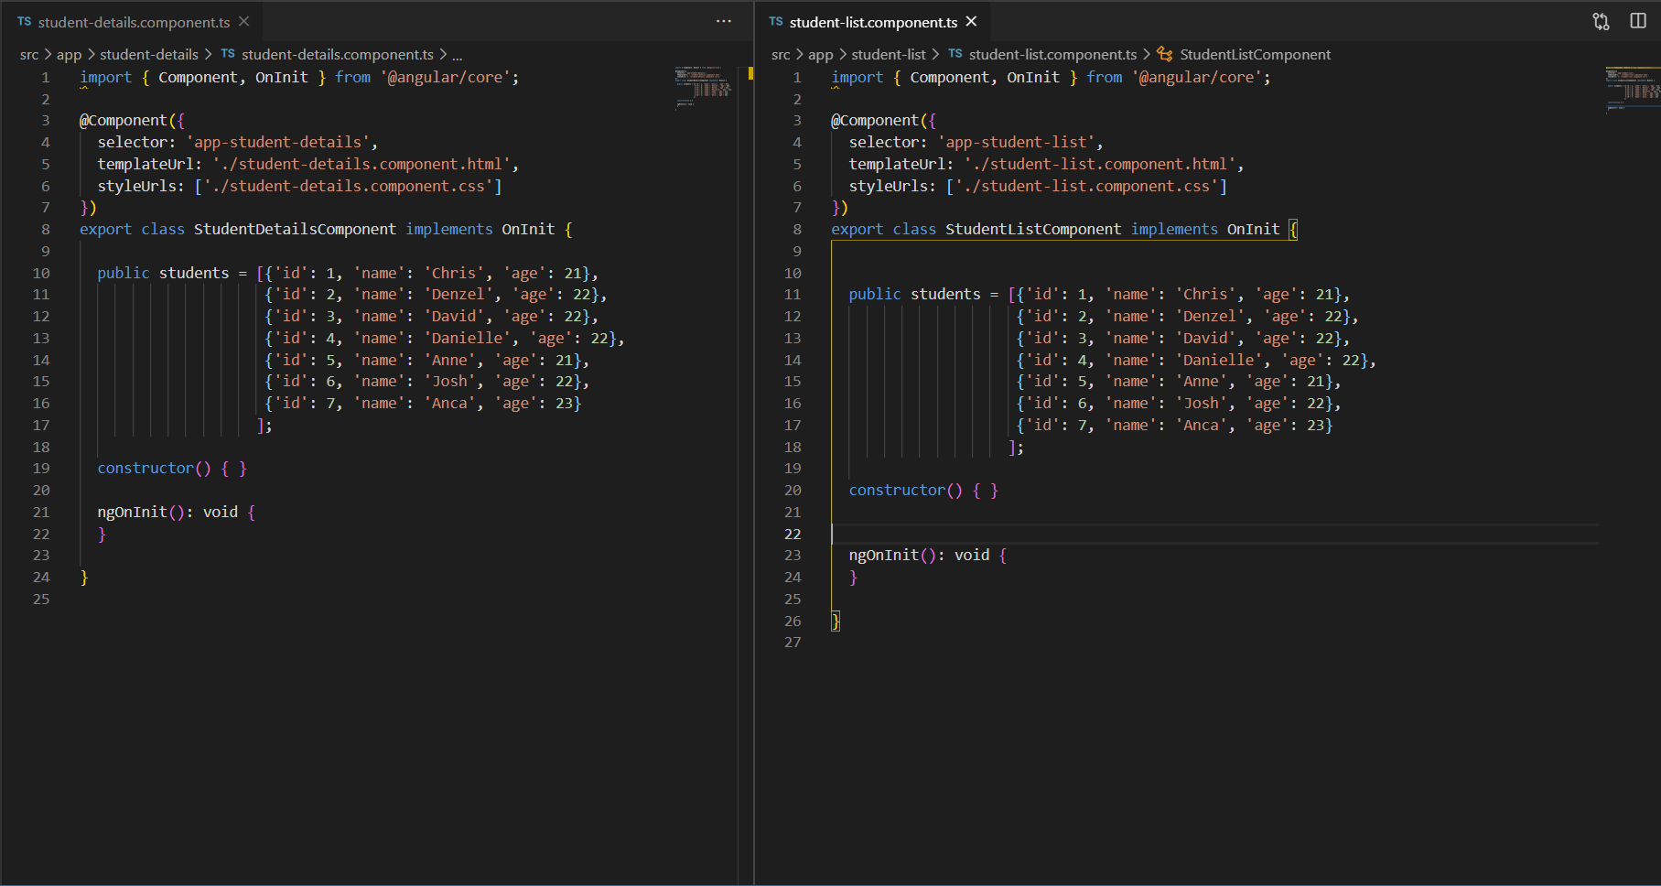

Slide 6
Angular service Info
It is a category that focus a value or feature an application need.
It can be used:
to share data through many components at once.
as a backend in angular to test code.
to connect to a database.

Slide 7

Let get started
Make a student.service.ts file
In order to provide the student data we need the service to handle that aspect of the code
Make a “Server” using a Http Request and an observable
Get an http request to the “server” to then return as an observable to student.service.ts and to the list and details.
Stu-List
“DB”
Get
Request
Student Service
HTTP
Stu-Details
Observ.
Response

Slide 8
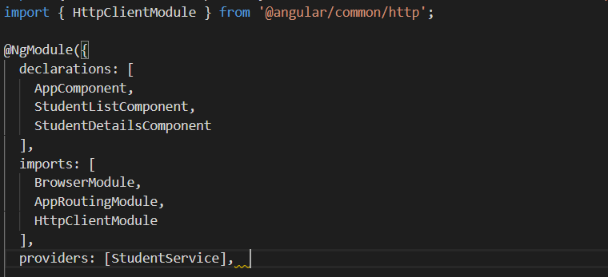
HTTP
Add import { HttpClientModule } from '@angular/common/http’; in the app.module.ts
Add HttpClientModule under imports
Add StudentsService under providers

Slide 9
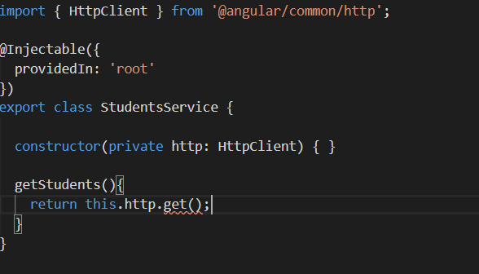
Declaring Dependencies for service
In student.service.ts under the constructor’s parameters, type private http: HttpClient and add the import
This uses the local variable http to reference the HttpCient
Make a get request
This will help when having a URL to get the data from the database. Since we don’t have a server we will make one in Angular using JSON.

Slide 10
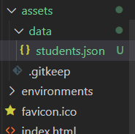
Data Folder
Under assets make a data folder and make a json file named students.json
After that copy and paste the data below and delete the ones from student-list & student-details
[
{"id": 1, "name": "Chris", "age": 21},
{"id": 2, "name": "Denzel", "age": 21},
{"id": 3, "name": "David", "age": 21},
{"id": 4, "name": "Danielle", "age": 21},
{"id": 5, "name": "Josh", "age": 21},
{"id": 6, "name": "Anne", "age": 21},
{"id": 7, "name": "Anca", "age": 21},
{"id": 8, "name": "John", "age": 21}
]

Slide 11

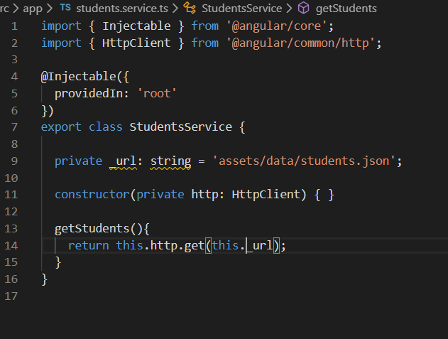
Make a URL
Making this url will direct it to the json file in the data folder.
If there is a URL that actually works replace the URL and the code should still work.

Slide 12
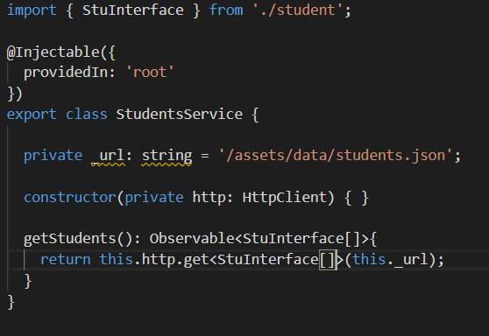
Observable
If you hover over the get() method it returns an observable so we need to be cased to match an array of students format in order for it to work
Create an interface named student.ts and add the code below
export interface StuInterface {
id: number;
name: string;
age: number;
}
Going back to the student.service.ts add the StuInterface[] to the get and the getStudents() will return an observable of StuInterface[] .

Slide 13
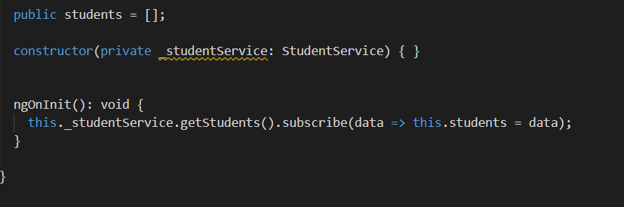
Subscribe
We need to subscribe to the data so that we can retrieve it.
Add private _studentService: StudentsService in the constructor parameters
Add this._studentService.getStudents().subscribe(data => this.students = data); in ngOnInit().
This goes for both student-list and student-details html.

Slide 14
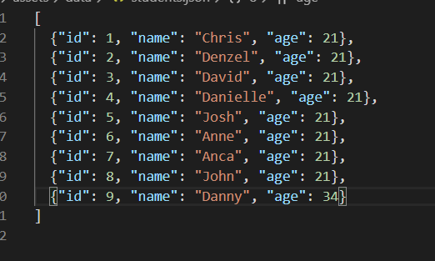
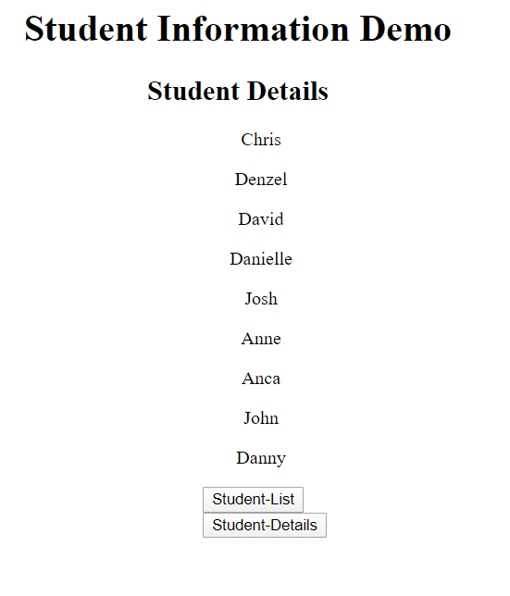
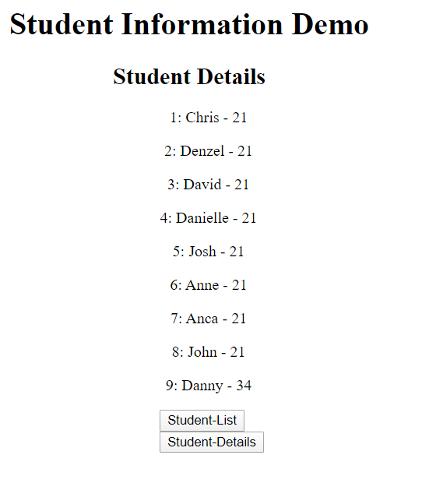
Conclusion
As we see if we add something to the json file it should add it to both pages and there is no need for repeting code.

Slide 15

Questions?

